Slide 1
8085 PIN Description

Slide 2
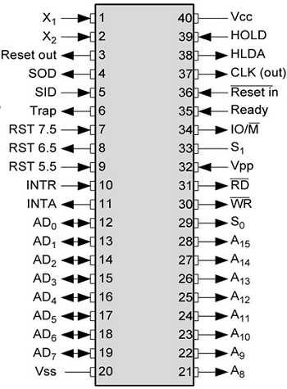
8085 microprocessor pin layout and signal groups

Slide 3
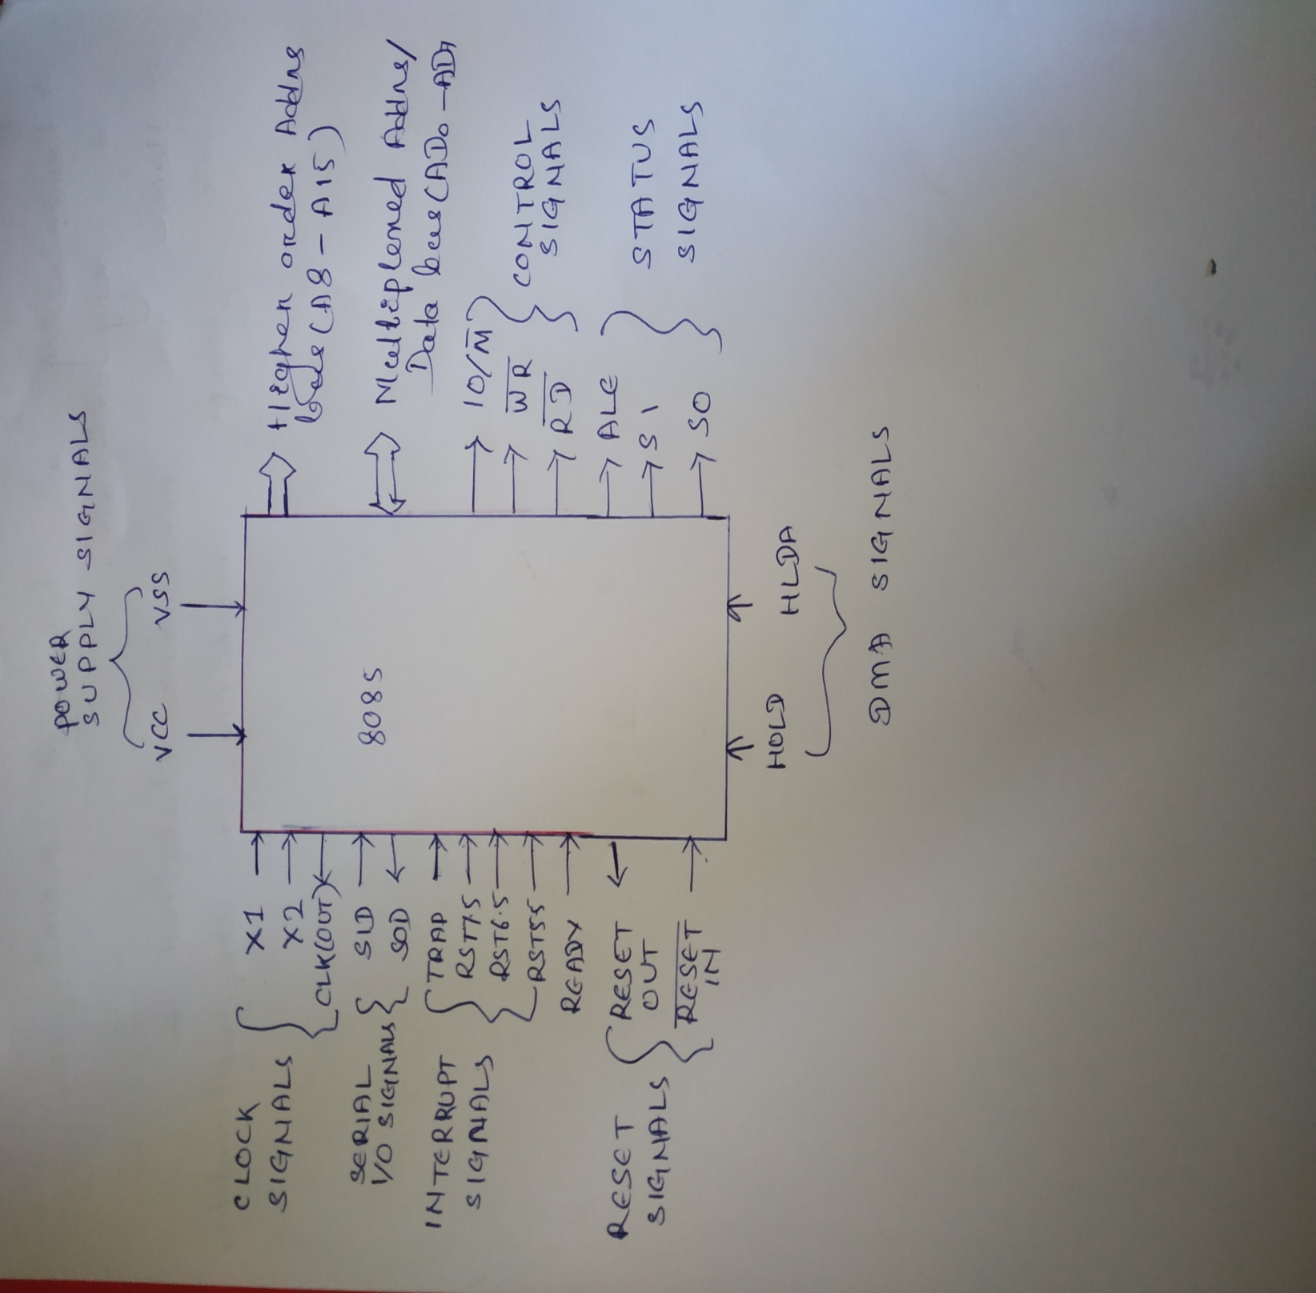

Slide 4
8085 has 40 pins.
The pins are categorized according to the different signals.
        Address bus
        Data bus
        Control & status signals
        Power supply and frequency signals
        Interrupt and Externally initiated signals
        Serial I/O signals

Slide 5
Address Buses: (A0-A15)
Send address to memory or IO.
Select one of the memory locations from I/O ports or memory.
Unidirectional
A8 – A15 (output-21-28): It carries the most significant 8-bits of memory/IO address.
AD0 – AD7 (input/output): It carries Lower significant bits of memory addresses.
Data Buses(D0-D7)
Bidirectional
Carries data between I/O or memory and microprocessor.
Multiplexed with lower LSB of address bus(A0-A7) hence AD0-AD7.
Control and status signals:
These signals are used to identify the nature of operation.
There are 3 control signal and 3 status signals.
Control Signal:
RD(active low) − The microprocessor reads data from memory or IO.
When it is high no data is read by MP
WR(active low) − The data on the data bus is to be written into a selected memory or I/O location.
ALE − It is a positive going pulse generated when a new operation is started by the microprocessor.
-When the pulse goes high, it indicates address. When the pulse goes down it indicates data.

Slide 6
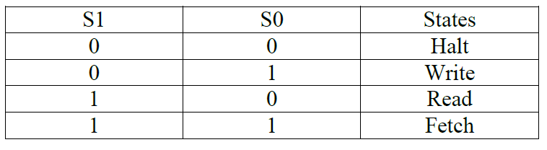
Status Signals:
IO/M(low)-
-When it is high it indicates I/O operation.
-LOW indicates Memory operations.
S1 & S0-
These signals are used to indicate type of operations.

Slide 7
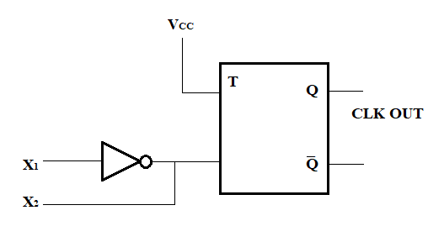
Power Supply:
Vcc: +5 V power supply
Vss: Ground reference
Clock signals:
X1, X2 −
It is to provide the required clock frequency to the microprocessor.
These are the two input lines across which a Crystal ( Crystal is the common term used in electronics for the frequency-determining component) is connected.
The frequency generated by the oscillator is divided by 2 to give the internal operating frequency of the microprocessor.
The input frequency is divided by 2 because the frequency is applied to the system through T flip flop. T flip flop divides the incoming frequency by 2.
CLK OUT − This signal is used as the system clock for devices connected with the microprocessor.

Slide 8
Interrupts & externally initiated signals:
Interrupts are the signals generated by external devices to request the microprocessor to perform a task.
There are 5 interrupt signals, i.e. TRAP, RST 7.5, RST 6.5, RST 5.5, and INTR.
INTA − It is an interrupt acknowledgment signal.
RESET IN(active low) − This signal is used to reset the microprocessor by setting the program counter to zero and the processor is reset
RESET OUT −
This signal is used to reset all the connected devices when the microprocessor is reset.
READY − This signal indicates that the device is ready to send or receive data. If READY is low, then the CPU has to wait for READY to go high.
HOLD − This signal indicates that another peripheral like DMA is requesting the use of the address and data buses.
HLDA (HOLD Acknowledge) −
This signal acknowledges the HOLD request.

Slide 9
Serial I/O signals:
There are 2 serial signals, i.e. SID and SOD and these signals are used for serial communication.
SOD (Serial output data line) − The output SOD is set/reset as specified by the SIM instruction.
SID (Serial input data line) − The data on this line is loaded into accumulator whenever a RIM instruction is executed.

